Slide 1


FRAUD
DETECTION
IN FINANCIAL TRANSACTIONS

Slide 2
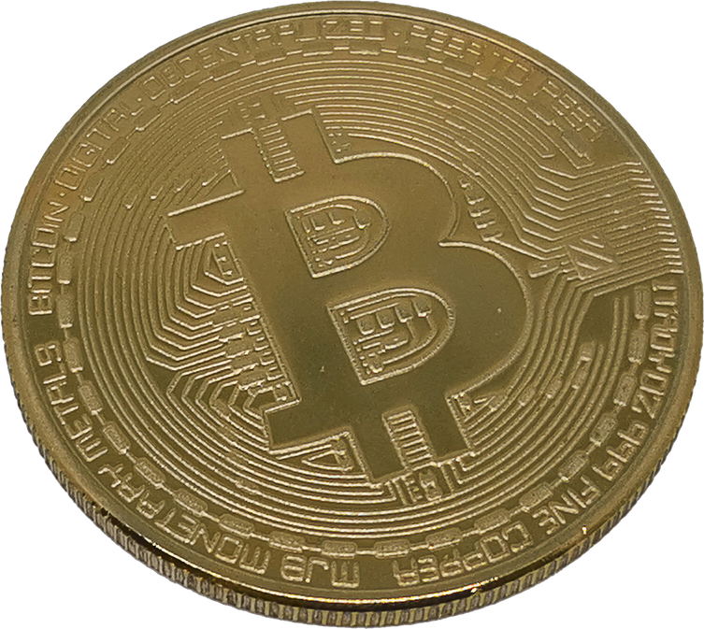


Team Members :
1- Eman Yousef
2- Fatma Ahmed
3- Sara Ahmed
4- Mohammed Ayman
5- Mohammed Mahmoud

Slide 3
Team Members Roles :
Data Preprocessing & ML models | Eman Yousef & Fatma Ahmed
Embedding & NLP models | Mohammed Aymen & Mohammed Mahmoud
MLflow | Sara Ahmed
GAN | Fatma Ahmed
Deployment | Eman Yousef & Fatma Ahmed

Slide 4

Why Detecting Fraud is Important?
Notes:
financial Loss Prevention
Fraud causes significant financial losses.
Early detection prevents large-scale monetary damage from unauthorized transactions.
Protecting Customer Trust
Customers depend on businesses to secure their data and finances.
Detecting fraud protects customer trust by preventing unauthorized access.
Reducing Operational Costs
Addressing fraud is costly after it occurs.
Early detection reduces the resources needed for investigations and damage control.

Slide 5
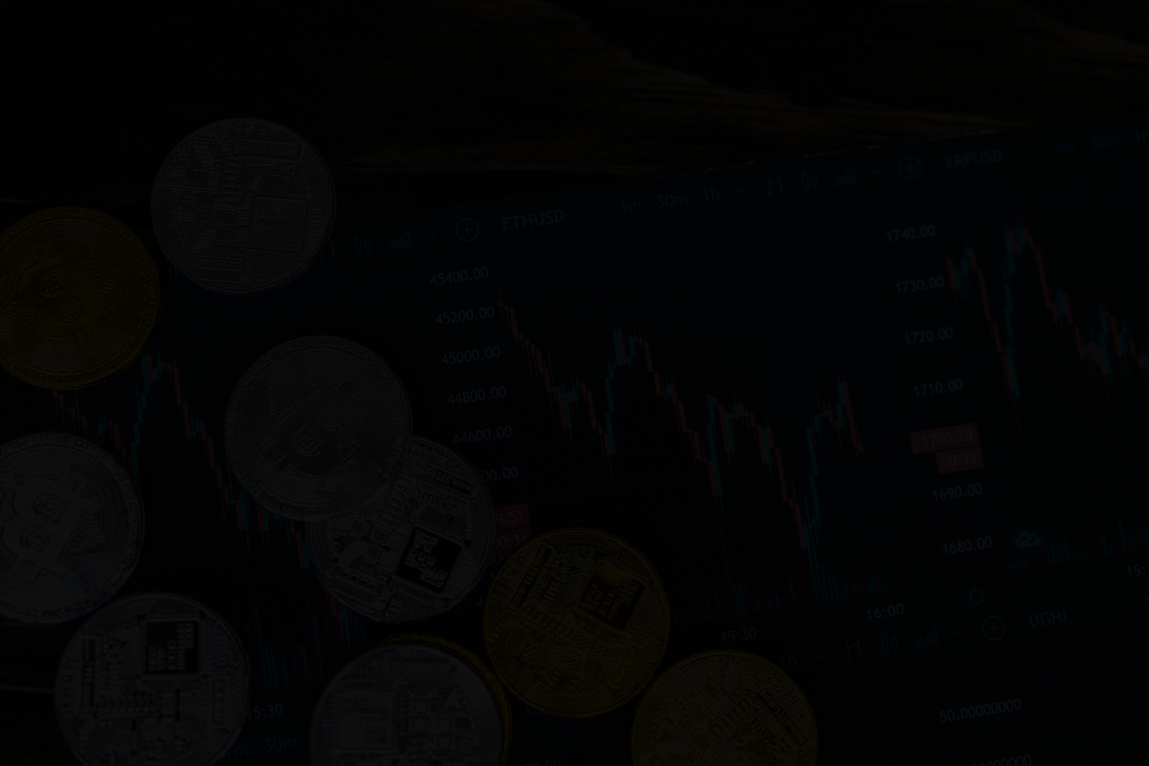
Dataset Overview
sample of real transactions extracted from one month of financial logs from a mobile money service implemented in an African country
Dataset shape before preprocessing : (6 362 620, 11)
Dataset shape after preprocessing : (11 260 389, 4)
Dataset Link

Slide 6
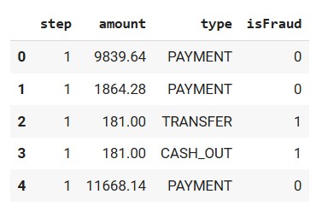
Key Features Used
Step: Represents the time step of the transaction.
Amount: The monetary value of the transaction.
Type: Type of transaction (e.g., PAYMENT, TRANSFER, CASH_IN).
IsFraud: Binary label indicating fraudulent (1) or non-fraudulent (0) transactions.
Dataset Link

Slide 7
Data Preprocessing & Imbalance Handling :
Clean the data (handling missing values, outliers).
SMOTE: Applied SMOTE to handle class imbalance by creating synthetic samples of the minority class (fraudulent transactions) to improve model performance.
Dataset Link

Slide 8
Additional Dataset :
A new dataset used with an additional feature, "action sequence", which tracks user behavior patterns or transaction sequences.
Dataset shape : 105 302 rows × 6 columns
Research Link

Slide 9
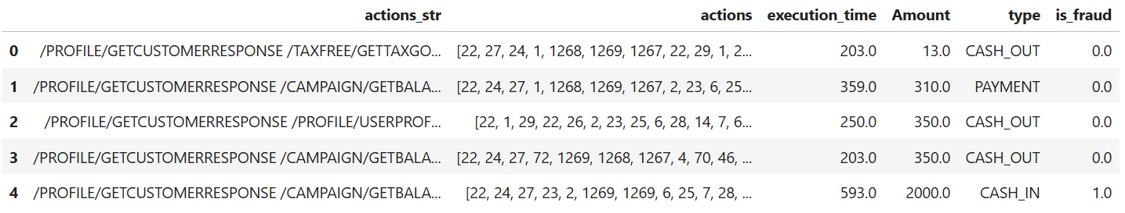
Key Features Used
Dataset Link

Slide 10

Embedding
GloVe
(Global Vectors for Word Representation) A technique that transforms words into continuous vector spaces.
First, we preprocess data (e.g. lowercase, remove punk, tokenization).
Second, Text to sequence.
Third, padding.

Slide 11


Logistic Regression
Decesion Tree
Random Forest
Model Selection
LSTM
GRU
Fully Connected Neural Network

Slide 12
Machine Learning Models
For non-actions sequence data

Slide 13
Models Performance Comparison :
Metric | Logistic Regression | Decision Tree | Random Forest
Train Accuracy | 79.1 % | 97.5 % | 96.7 %
Validation Accuracy | 79.1 % | 97.5 % | 96.7 %
Test Accuracy | 79.2 % | 99.9 % | 99.9 %

Slide 14
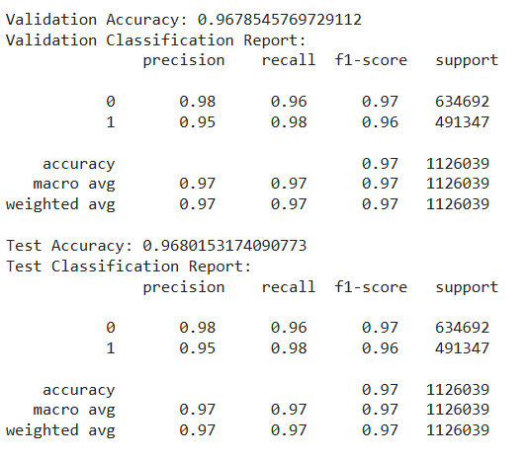
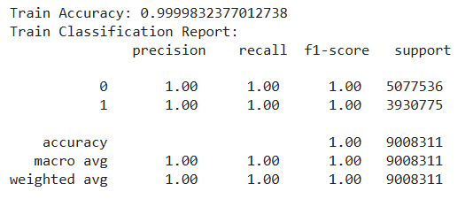
Classification Report :

Slide 15
Deep Learning Models
For actions sequence data

Slide 16
Models Performance Comparison :
Metric | FCNN | LSTM | GRU
Train Accuracy | 93.5 % | 99.8 % | 98.5 %
Test Accuracy | 95.2 % | 98.8 % | 98.3 %

Slide 17
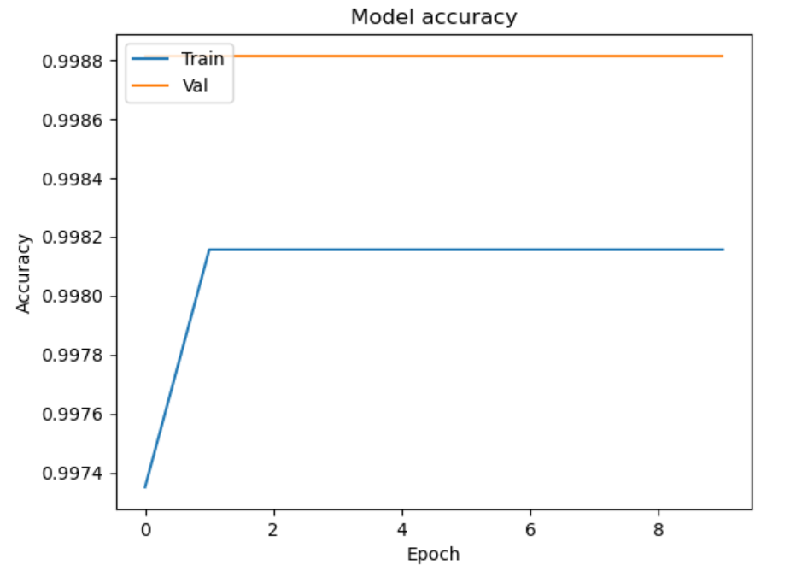
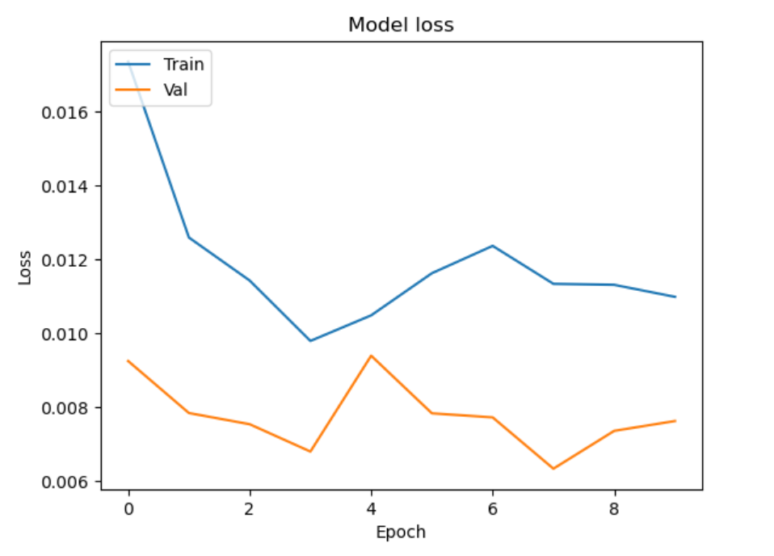

Slide 18
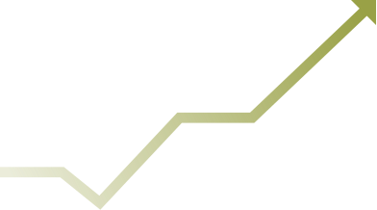

MLflow

Slide 19
Tracking with MLflow
MLflow:
•is an open-source platform designed to manage the complete machine
learning lifecycle, from experiment tracking to model deployment.
•It is compatible with popular machine learning libraries such as Scikit-learn,
TensorFlow, PyTorch, and others.
Benefits:
•Centralized Experiment Tracking
•Reproducibility
•Model Deployment

Slide 20

Tracking with MLflow
Setting Up MLflow UI:
Using Ngrok:
Exposed the MLflow UI to the internet for easy access.
Access Link:
Navigate to the MLflow UI.

Slide 21
Logging with MLflow
Model and Metrics Logged:
Model: Decision Tree
Metrics:
Validation Accuracy
Test Accuracy
AUC Score
Precision
Recall
F1 Score

Slide 22
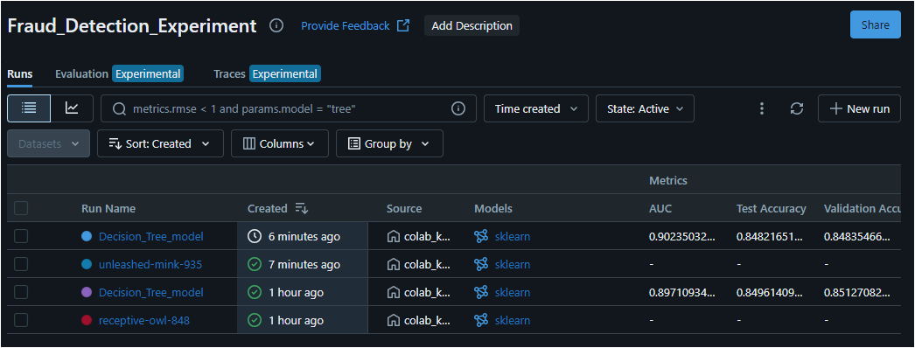
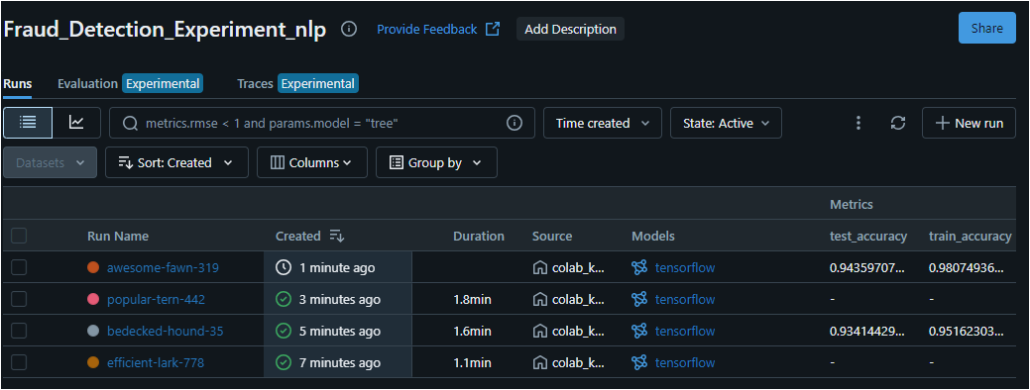
Decision Tree
LSTM

Slide 23
GAN

Slide 24
GAN
Generate synthetic transaction data to enhance the training dataset.
Challenges :
Training Complexity:
GANs is difficult to be trained and require careful tuning of hyperparameters.
Quality of Generated Data:
Ensuring that the synthetic data accurately reflects potential fraudulent transactions.

Slide 25
Deployment
Let’s see our website

Slide 26
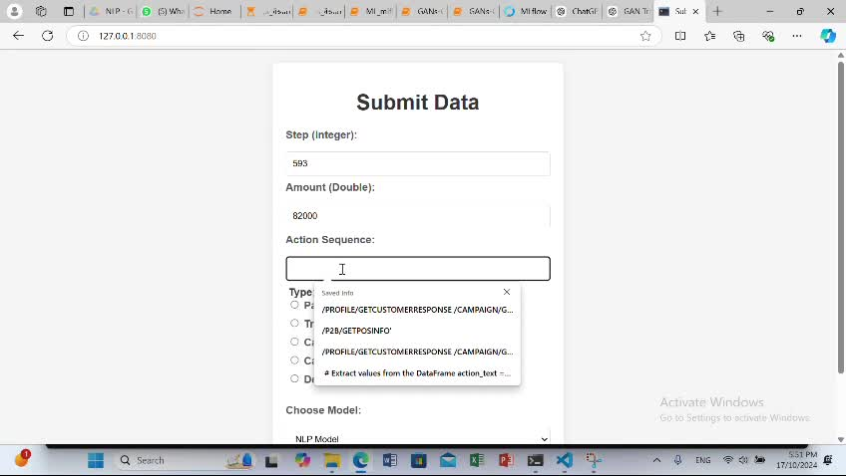

Slide 27


Thank
you.

